Slide 1

Twitter Analysis Tool (TAT)

Slide 2
Agenda
Product Overview
Customer Profile
Workflow
Strategic Features
Execution Plan
Our Team
Up Next

Slide 3
Product Overview
Customer Profile
Workflow
Strategic Features

Slide 4

Customer Profile
Objective
To do quick & real time analysis on any given topic using the Twitter data which can be extracted using the developer APIs.
Why Choose Twitter
Twitter defines its platform as "what's happening in the world and what people are talking about right now”. And Twitter holds around 8.5% of the world’s social media share and it is considered as official marketing platform for many top brands, leaders and celebrities.

Slide 5
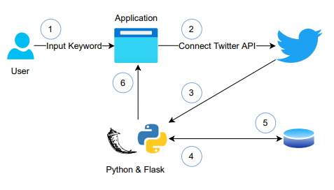
Workflow
1
Get the input keyword from user
2
Connect to the Twitter API
Fetch the data using Python packages
3
Store the data into database
4
Using Flask app, get the data from database and preprocess it
5
Show the analysis report in the UI
6

Slide 6

Strategic Features
First feature
Real-Time Analysis helps the users to see current sentiments
Second feature
Trends across any given topic across the market can be identified & analyzed
Third feature
Comes with intuitive features like Word cloud, trending Hashtags and Verified user's summary

Slide 7
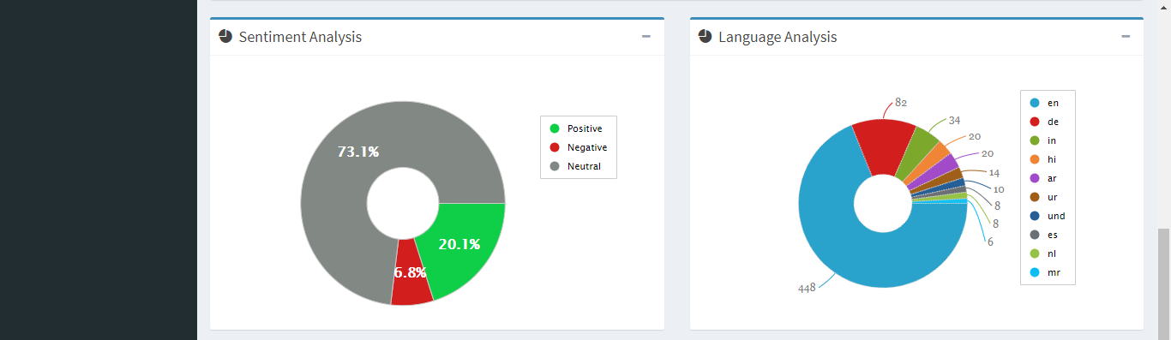
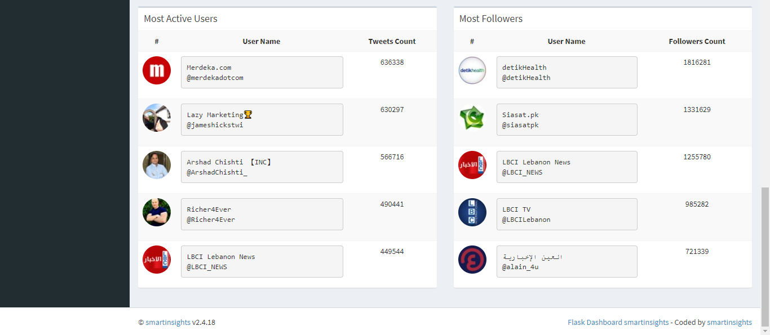
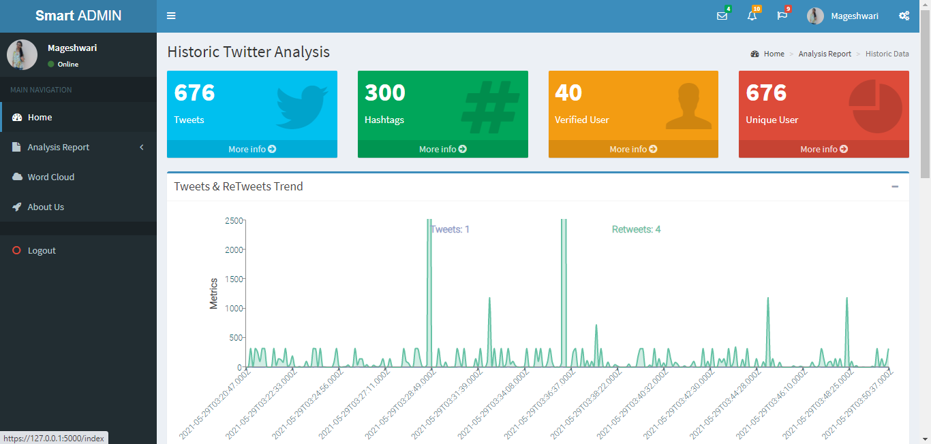
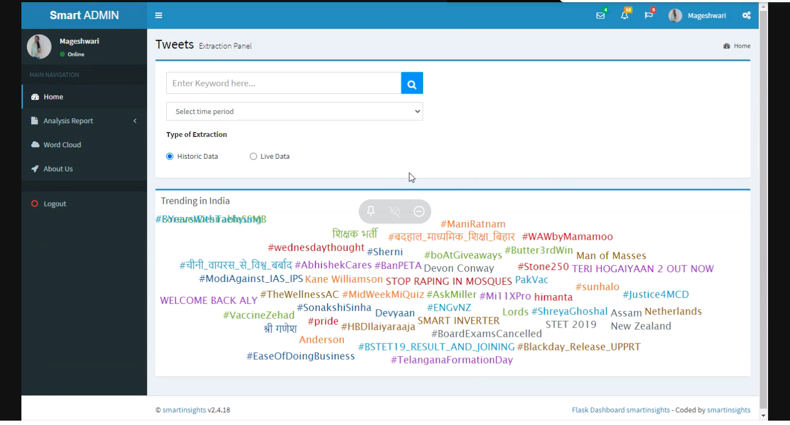

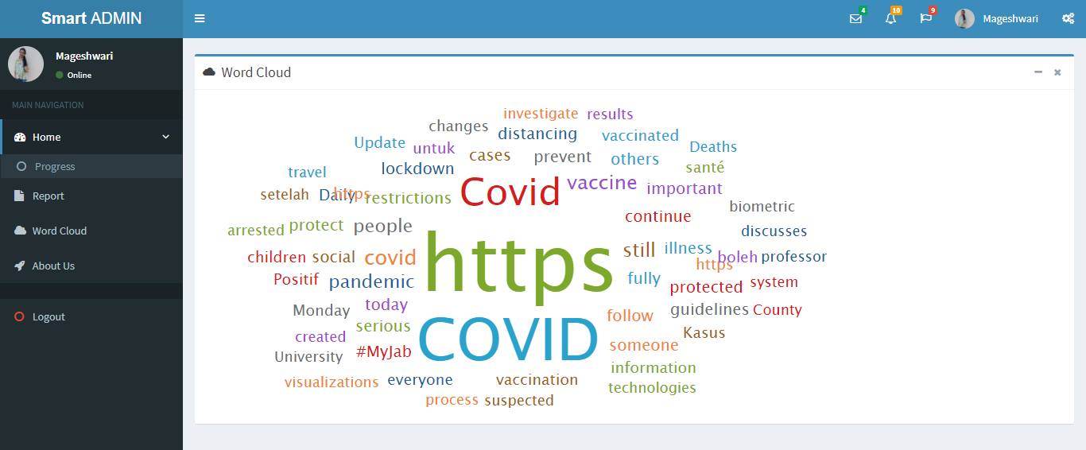

Snapshots of Tool

Slide 8
Execution Plan
Our Team
Up Next

Slide 9
Our Team
GANESH SANKARALINGAM Director
AJO SHYNIE Analyst
MAGESHWARI SINGARAVADIVELOU Analyst / Product Development
VIVEK SOUNDARAPANDIAN Manager

Slide 10

Up Next
Spam / Ham Classification on data
Text Analytics - Report
Email Notification
Download the Analysis Report

Slide 11
Thank you
Mageshwari singaravadivelou
mageshwarivelou@gmail.com

